Slide 1

Skincare Product Recommendation System
This presentation explores the development of a skincare product recommendation system. We will cover data exploration, preparation, and the TF-IDF model.
BK
by Ballar Neethu Kumari

Slide 2

Purpose and Need
The vast skincare market overwhelms consumers. Personalized guidance is crucial for effective product selection.
Overwhelmed Consumers
Many product choices create confusion. Shoppers need help finding suitable items.
Personalized Fit
Unique skin types require tailored recommendations for optimal results.
Enhanced Efficacy
Suggesting proven products improves user satisfaction and skin health.
Meeting Demand
The beauty industry values customized experiences and data-driven solutions.

Slide 3
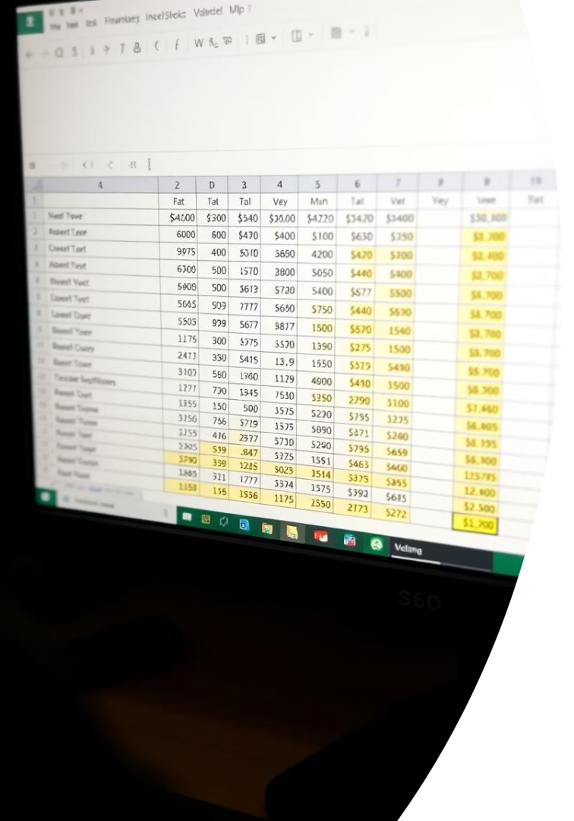
Dataset Overview
1224
14
Total Products
Duplicate Rows
Number of unique skincare products scraped.
Identified and removed for data cleaning.
9
Data Columns
Features like product name, brand, and skin type.

Slide 4
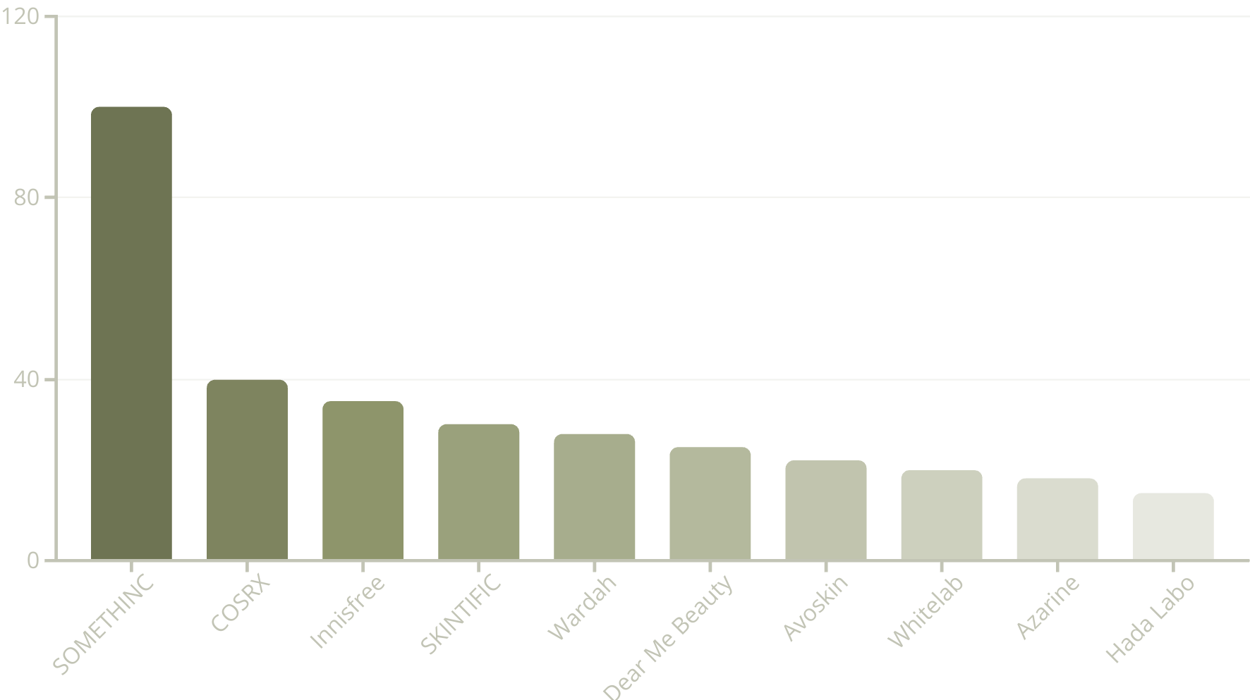
Top 10 Brands
SOMETHINC leads with the most products. This indicates a diverse product range from this brand.

Slide 5





Product Type Distribution
Toner
Serum
20.83%
25.08%
2
1
Moisturizer
3
20.26%
5
Face Wash
4
16.50%
Sunscreen
17.32%
Serums are the most common product type. This suggests high demand or variety in serum offerings.

Slide 6

Skin Type Suitability
Oily Skin
Many products are suitable for oily skin.
Dry Skin
Products also cater to dry skin needs.
Combination Skin
A significant portion addresses combination skin.
Normal Skin
General products for normal skin are available.

Slide 7
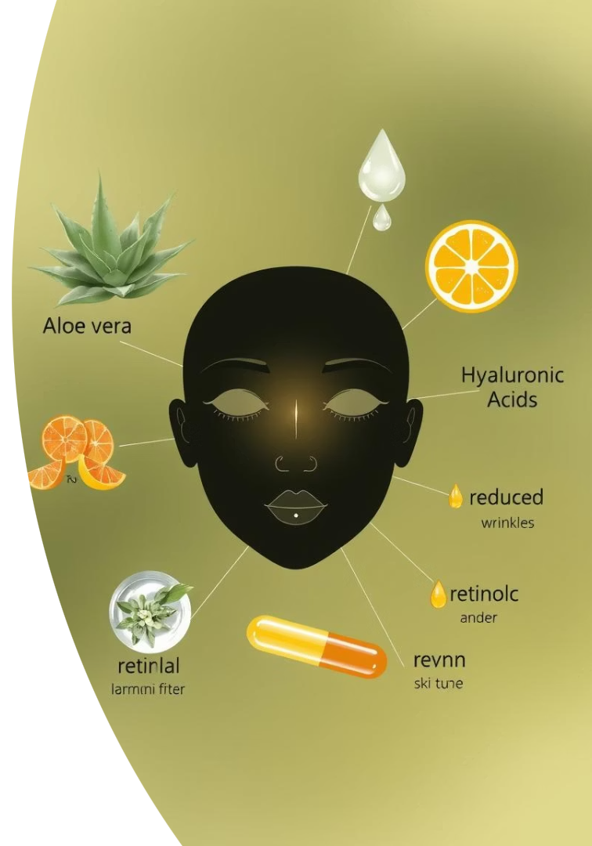




Top Notable Effects
Pore Care
Brightening
Anti-Aging
Addresses pore concerns.
Enhances skin radiance.
Reduces signs of aging.
Hydrating
Provides essential moisture.
Pore care, brightening, and anti-aging are the most common notable effects. Many products offer multiple benefits.

Slide 8




TF-IDF Vectorization
Initialize TF-IDF
Using TfidfVectorizer with stop words.
Transform Effects
Applies TF-IDF to notable effects.
Create Matrix
Converts TF-IDF output to a matrix.
TF-IDF helps represent notable effects as important features. This is crucial for our recommendation system.

Slide 9
Cosine Similarity for Recommendations
Similarity Calculation
Recommendation Logic
Cosine similarity measures product resemblance. It compares TF-IDF matrices.
The system identifies products with highest similarity. It excludes the queried product.

Slide 10

Thank You

